Slide 1
A NOVEL FACE RECOGNITION METHOD USING PCA, LDA AND BAYESIAN CLASSIFIER
BATCH MEMBERS
A.T.KARTHIK RAJAA J.JERWIN SAMUEL
M.ESAKKI RAJ I.V.VISHAL
INTERNAL GUIDE
Mr.C.MURUKESH, M.E.
Assistant Professor/EIE
DEPARTMENT OF ELECTRONICS & INSTRUMENTATION ENGINEERING
VELAMMAL ENGINEERING COLLEGE , CHENNAI-66.

Slide 2
OBJECTIVES
To recognize a sample face from a set of given faces .
2) Use of Principal Component Analysis [Using Eigen face approach].
3) To Use Bayesian approach for recognition and compare
it with Eigen face approach.

Slide 3
FACE RECOGNITION
Face recognition is basically an attempt to develop a machine to mimic the human capability to distinguish different human faces.
The term ‘recognition’ has been used to refer to many different visual abilities, including identification, categorization, and discrimination.
INPUT IMAGE
PREPROCESSING
DIMENSIONALITY REDUCTION
FEATURE EXTRACTION
CLASSIFICATION

Slide 4
APPLICATIONS OF FACE RECOGNITION SYSTEM:
Access Control
Identification systems
Surveillance
FACE RECOGNITION TECHNIQUES:
Knowledge based methods
Feature invariant approaches
Template matching methods
Appearance based methods

Slide 5
APPEARANCE BASED METHOD
Appearance based methods rely on techniques from statistical analysis and machine learning to find the relevant characteristics of face and non-face images.
The learned characteristics are in the form of distribution models or discriminant functions that are consequently used for face recognition.

Slide 6
Bayesian classification or maximum likelihood can be used to classify a candidate image location as a face or non-face.
A face recognition system generally consists of 4 modules :
i) Preprocessing
ii) Dimensionality reduction using PCA
iii) Feature extraction for class separability using LDA
iv) Classification using Bayesian network

Slide 7
PREPROCESSING
Image pre-processing is the name for operations on images at the lowest level of abstraction whose aim is an improvement of the image data that suppress undesired distortions or enhances some image features important for further processing.
Histogram Equalization
Normalization
Image Scaling
Image Rotation

Slide 8
HISTOGRAM EQUALIZATION
Histogram Equalization is process that attempt to spread out the gray levels in an image so that they are evenly distributed across their range.
Histogram equalization reassigns the brightness values of pixels based on the image Histogram.
Histogram equalization is a technique where the histogram of the resultant image is as flat as possible.
Histogram equalization provides more visually pleasing results across a wider range of images.

Slide 9
NORMALIZATION
Contrast stretching or normalization is a simple image enhancement technique used to improve the contrast in an image by `stretching' the range of intensity values it contains to span a desired range of values, e.g. the full range of pixel values that the image type concerned allows.

Slide 10
PRINCIPAL COMPONENT ANALYSIS
Principal component analysis (PCA) is a classical statistical method.
This linear transform has been widely used in data analysis and compression.
Principal Components Analysis is a method that reduces data dimensionality by performing a covariance analysis between factors.

Slide 12
There are M images in the training set.
2. There are K most significant Eigenfaces using which we can satisfactorily approximate a face. K < M.
3. All images are N x N matrices, which can be represented as N² x 1 dimensional vectors. The same logic would apply to images that are not of equal length and breadths. To take an example: An image of size 112 x 112 can be represented as a vector of dimension 12544 or simply as a point in a 12544 dimensional space.

Slide 13
LINEAR DISCRIMINANT ANALYSIS
Linear Discriminant Analysis (LDA) is a well-known scheme for feature extraction and dimension reduction.
It has been used widely in many applications involving high-dimensional data, such as face recognition and image retrieval.
The algorithm, called PCA+LDA, is used widely in face recognition.

Slide 14
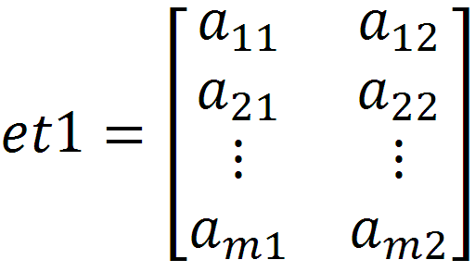
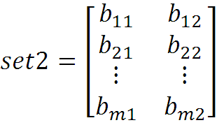
Mathematical operations
Data sets and the test sets are formulated, which are to be classified in the original space.
s
Compute the mean of each data set and mean of entire data set. Let and be the mean of set 1 and set 2 respectively and be mean of entire data, which is obtained by merging set 1 and set 2.

Slide 15


Bayes Theorem
Bayes' theorem expresses the conditional probability, or "posterior probability", of a hypothesis H (i.e. its probability after evidence E is observed) in terms of the "prior probability" of H, the prior probability of E, and the conditional probability of E given H. It implies that evidence has a confirming effect if it is more likely given H than given not-H.
Mathematically, Bayes' rule states,
or, in symbols,

Slide 16
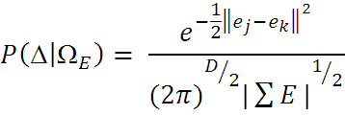
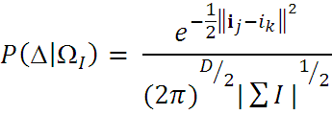


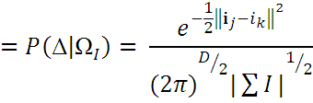
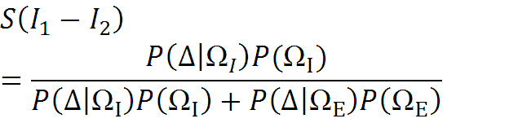

These likelihoods are then used to compute the MAP similarity S in eq2; since the Euclidean distances and in the exponents of are of dimensions
and
for the i and e vectors, respectively, only
Probabilistic Similarity Measures

Slide 17


Bayesian Maximum Likelihood Estimation
We have used a probabilistic similarity measure based on the Bayesian belief that the image intensity differences, denoted by,
are characteristic of typical variations in appearance of a individual. In particular, we define two classes of facial image variations: intrapersonal variations,
(corresponding, for example to different facial expressions of the same individual) and extra personal variations,
(corresponding to variations between different individuals). Our similarity measure is then expressed in terms of the probability.
(1)
Where
is the a posteriori probability

Slide 18
Maximum likelihood estimation (MLE)
Likelihood is a function of the parameters of a statistical model. The likelihood of a set of parameter values given some observed outcomes is equal to the probability of those observed outcomes given those parameter values
Maximum likelihood estimation (MLE) is a statistical method used for fitting a statistical model to data, and providing estimates for the model's parameters.
Conditional Probability
Conditional probability is the probability of some event A, given the occurrence of some other event B. Conditional probability is written P(A|B), and is read "the (conditional) probability of A, given B" or "the probability of A under the condition B".

Slide 19




However, these computations can be greatly simplified by offline transformations. To compute the likelihoods
and
we pre process the
images with whitening transformations and consequently every image is stored as two vectors of whitened subspace coefficients; i for e intrapersonal and e for extra personal.
After this preprocessing and with the normalizing denominators precomputed, evaluating the likelihoods is reduced to computing simple Euclidean distances for the exponents

Slide 20
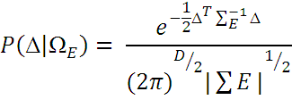
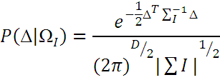
Efficient Similarity Computation
The two classes of interest in this space correspond to intrapersonal and extra personal variations and each is modeled as a high dimensional Gaussian density.

Slide 21
REFERENCES
A New Face Recognition using PCA, LDA and Neural Classifier www.waset.org/journals/waset/v41/v41-2.pdf
Atick.J, and Penev P. ''Local feature analysis: A general statistical theory for object Representation,'' Network: Computation in Neural Systems, vol.7, pp. 477-500, 1996.
Chai. D., S. L. Phung and A. Bouzerdoum A Bayesian Skin/Non- Skin Color Classifier Using Nonparametric Density Estimation in the Proceedings of IEEE.
Chellappa.R, K. Etemad and ''Discriminant analysis for recognition of human face images,'' Journal of the Optical Society of America, vol. 14, pp. 1724-1733,
5. Face Recognition Home Page., www.face-rec.org
6. FERET Database http://www.itl.nist.gov/iad/humanid/feret/
7. Gonzalez, Woods, and Eddins., Digital Image Processing Using MATLAB 2nd Ed by © 2009. Gatesmark Publishing.

